Slide 1
Smoothing your data with polynomial fitting: a signal processing perspective
Cees Taal

Slide 2
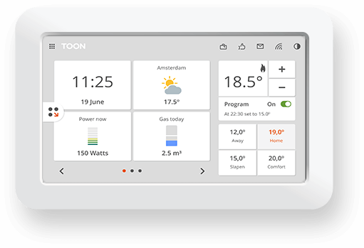
About me (Cees Taal)
Academia:
PhD, TU Delft, speech signal processing (2008-2012)
Postdoc, KTH, Stockholm, speech enhancement (2013)
Postdoc, LUMC, Leiden, Cochlear implants (2014)
Industry:
Philips Research, biomedical signal processing (2014-2016)
Toon, IoT data processing/analysis (2016-now)

Slide 3

I have to confess…
8 years of Matlab
Python since last year
Best decision ever :)
Pycharm IDE
Matlab→Python? Just ask me!

Slide 4
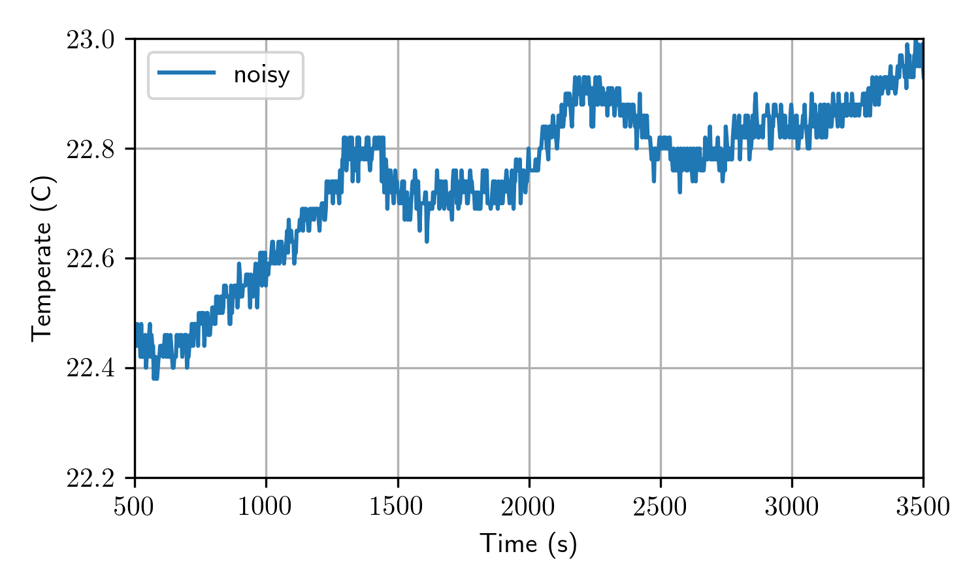
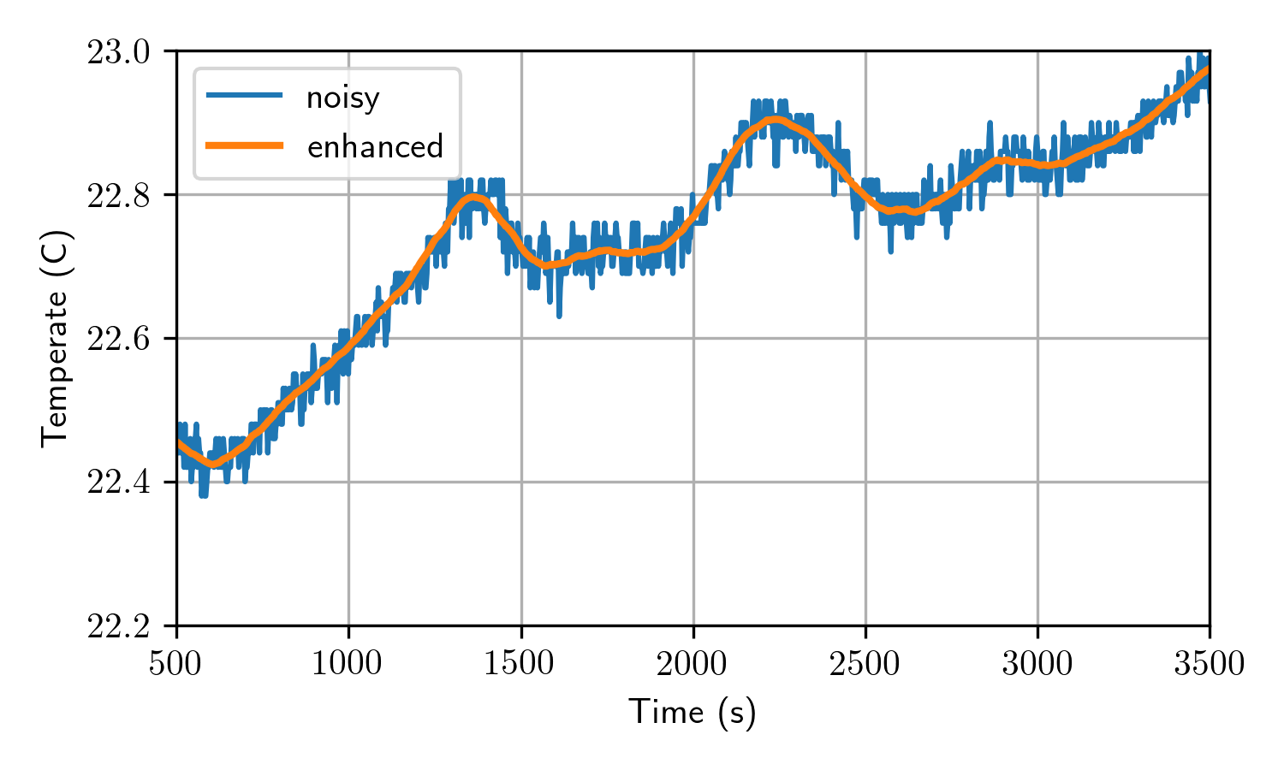
Motivation
Remove noise from your data
With polynomial fitting
Electrical Engineering
Computer Science
A signal processing perspective?
Savitzy-Golay filtering
Frequency domain interpretation
Not today’s topic: Optimal noise removal
Signal Processing

Slide 5
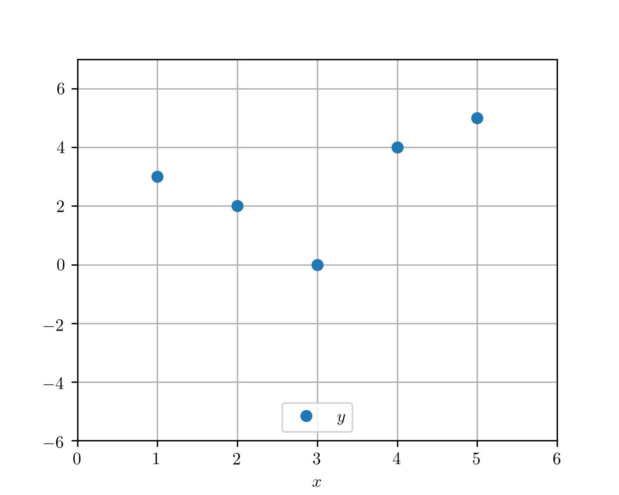
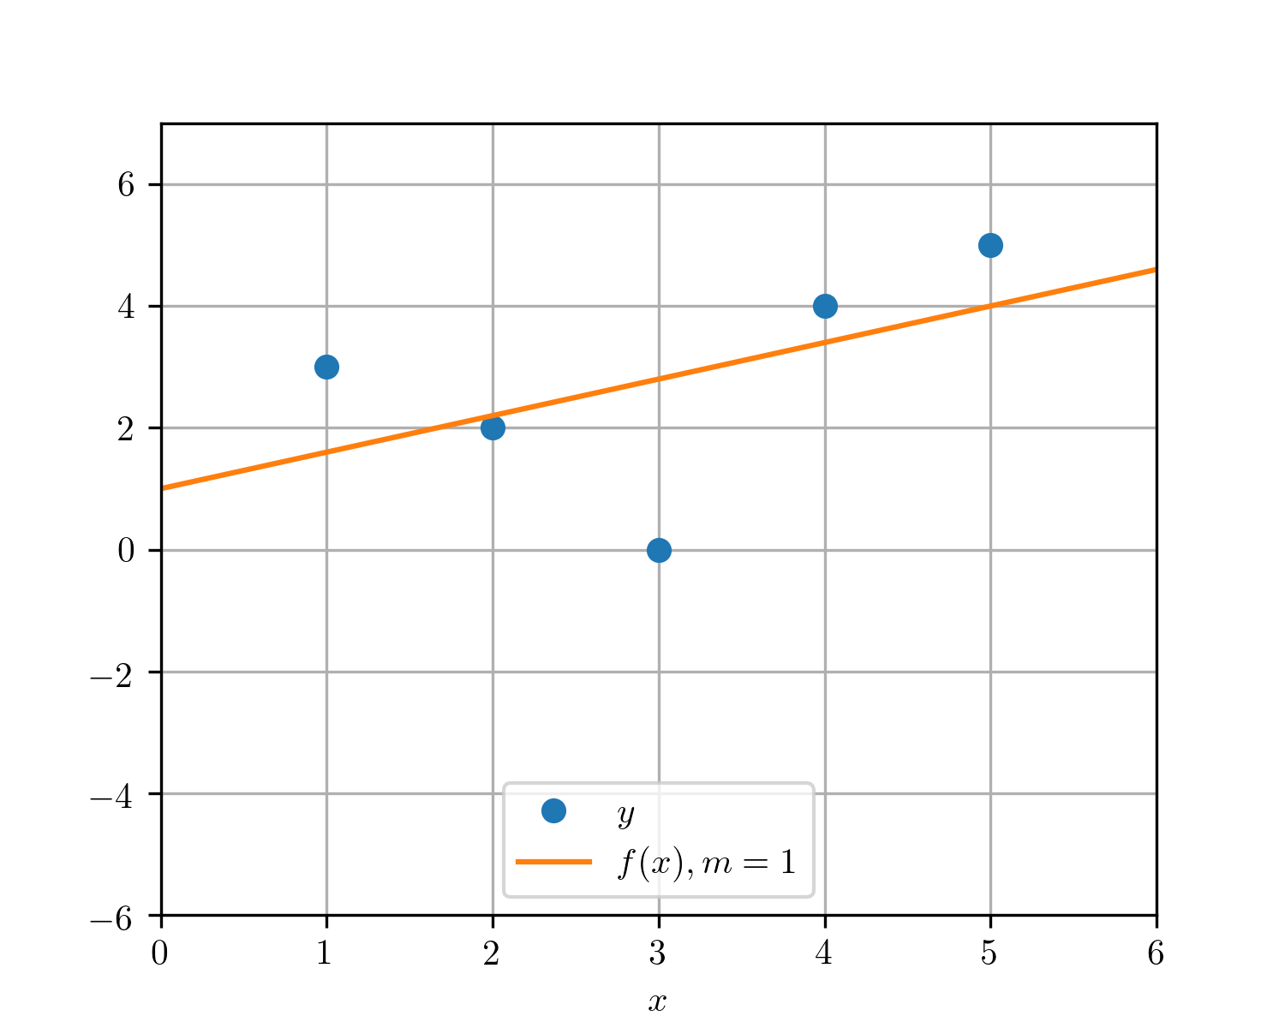
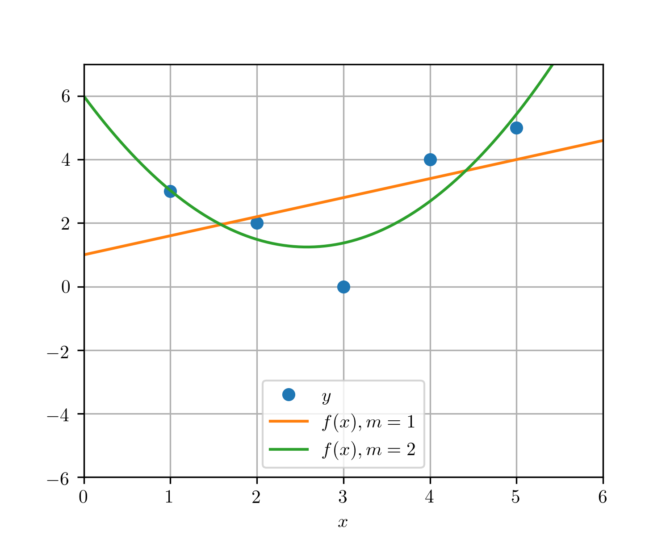
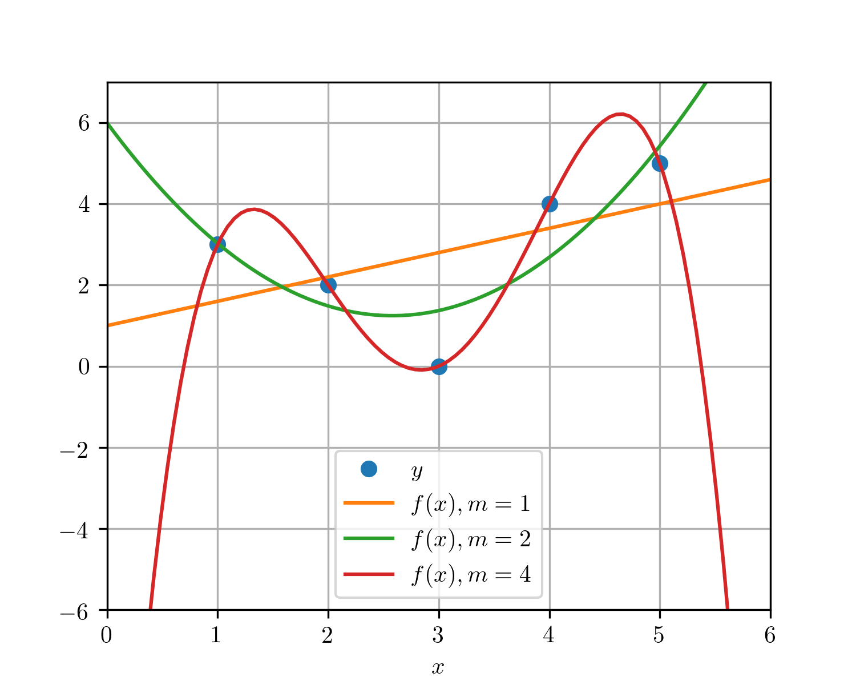
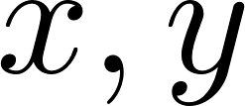
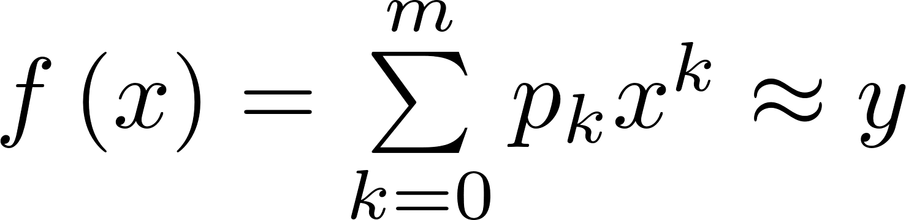
Polynomial fitting
p = np.polyfit(x, y, deg=m)
y_fit = np.polyval(p, x)
Given a set of data points:
Polynomial fit:

Slide 6
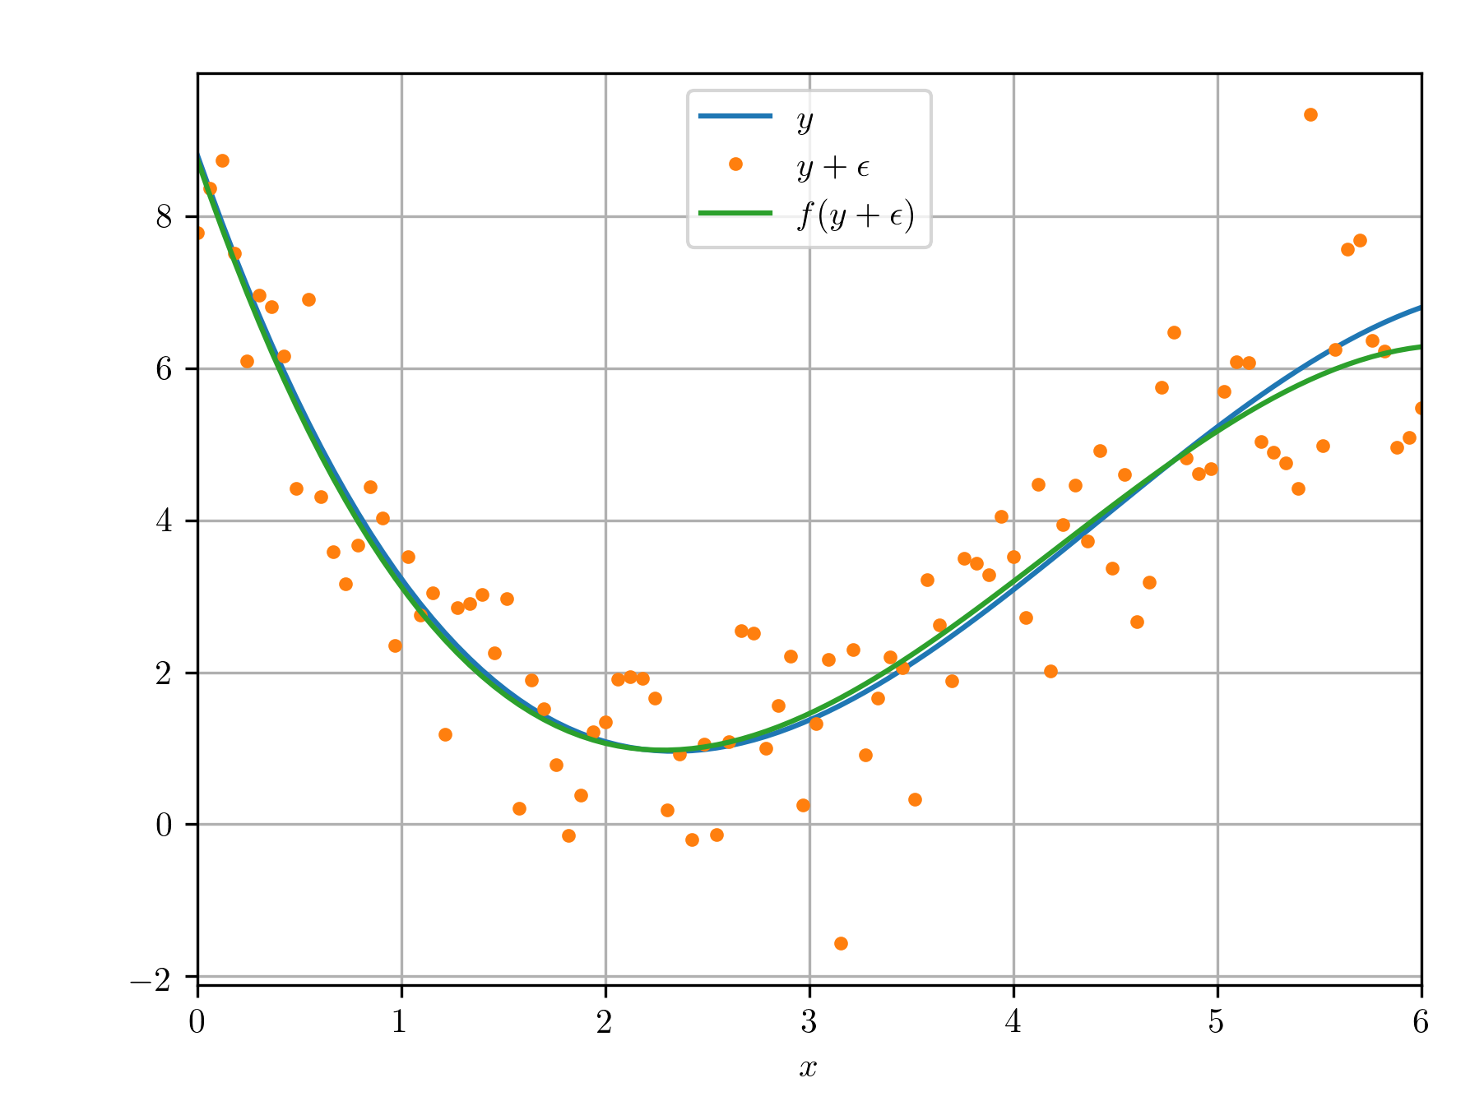
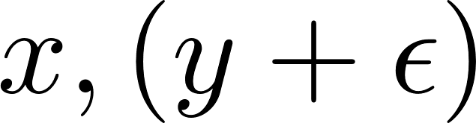
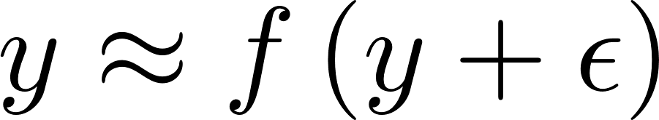
Polynomial fitting - smoothing
In the real world we have noise:
Use fit to estimate clean data:

Slide 7
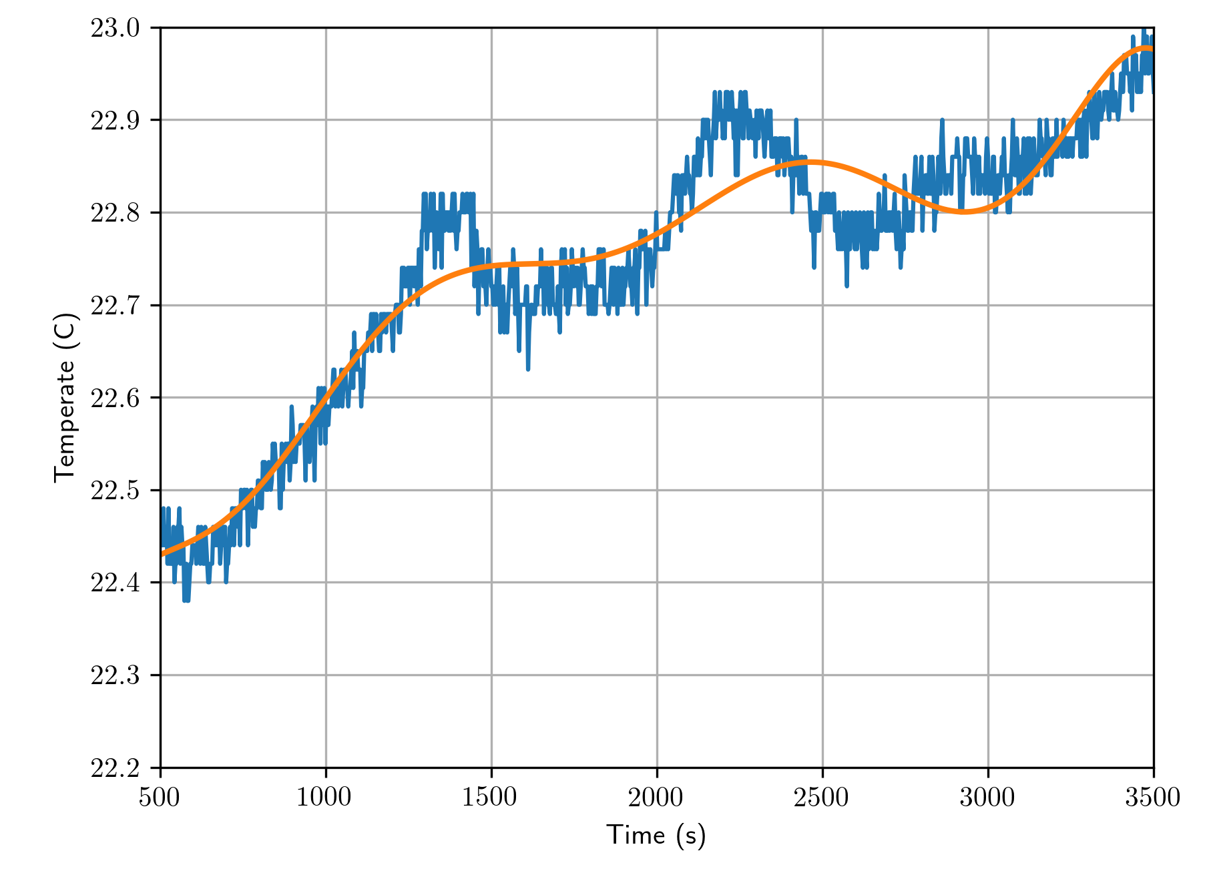
Polynomial fitting - windowing
(10th degree fit)
Difficult to fit long time-varying signals:
Need high polynomial degree
Numerical errors
Alternative approach:
Fit in short-time windows
Better fit with low degree

Slide 8
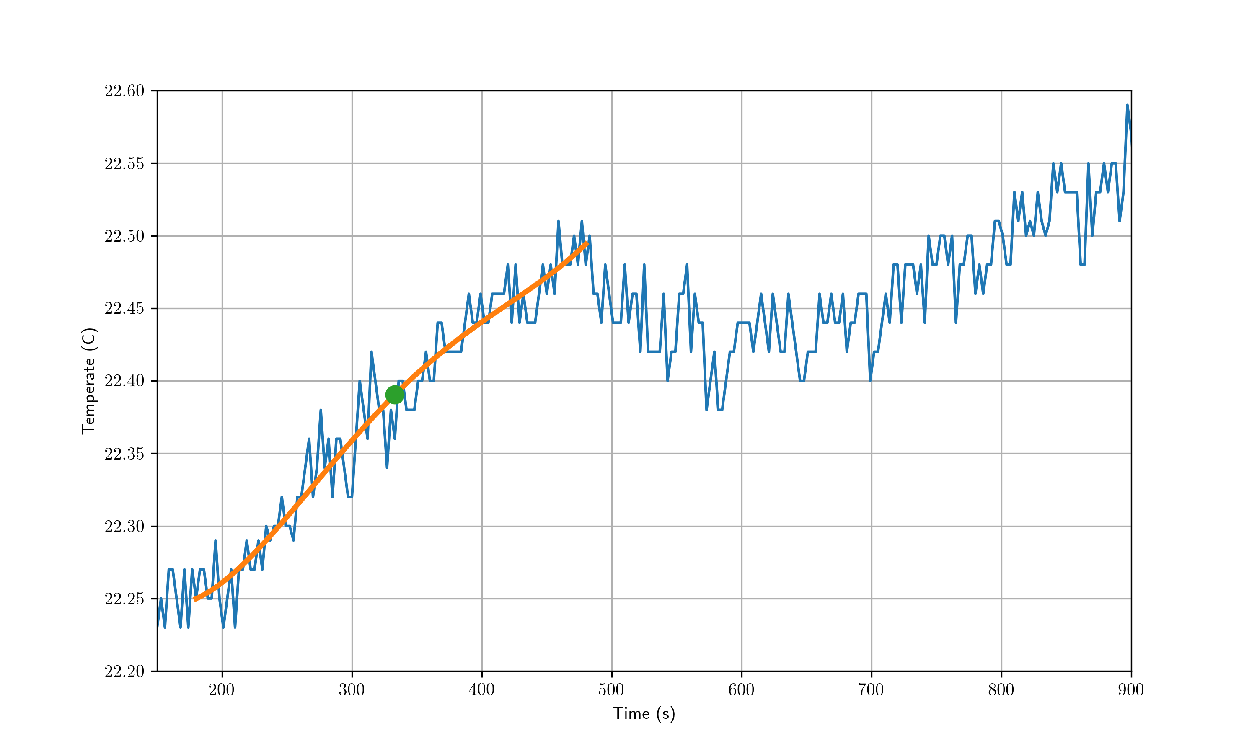
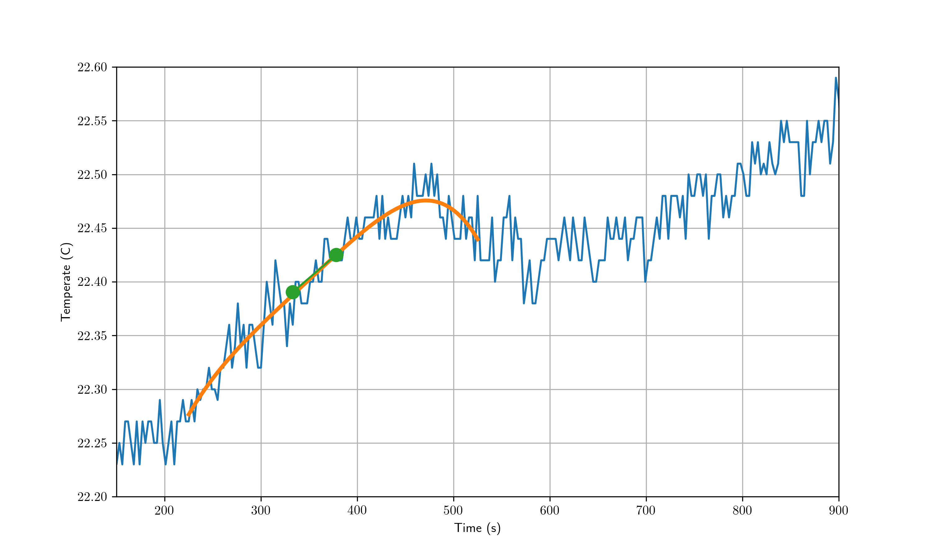

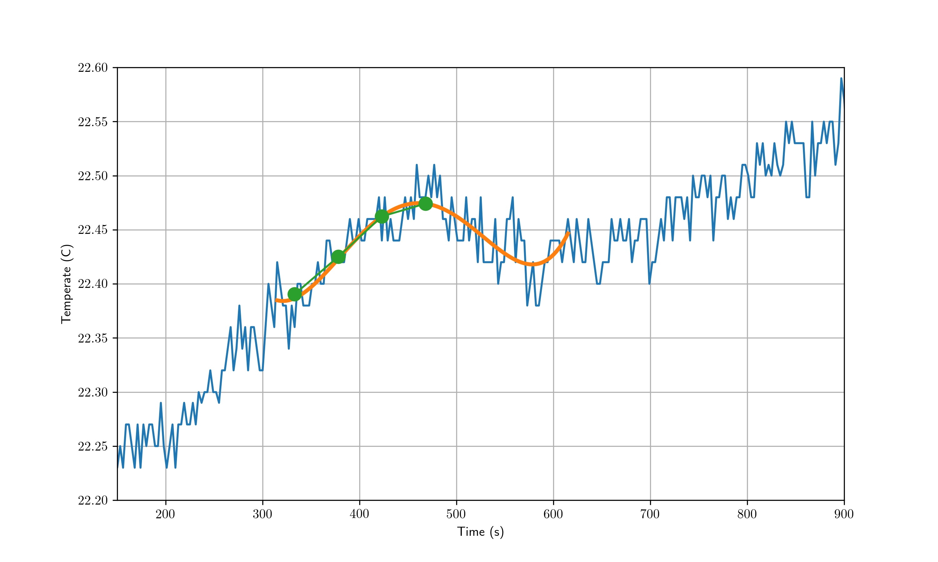
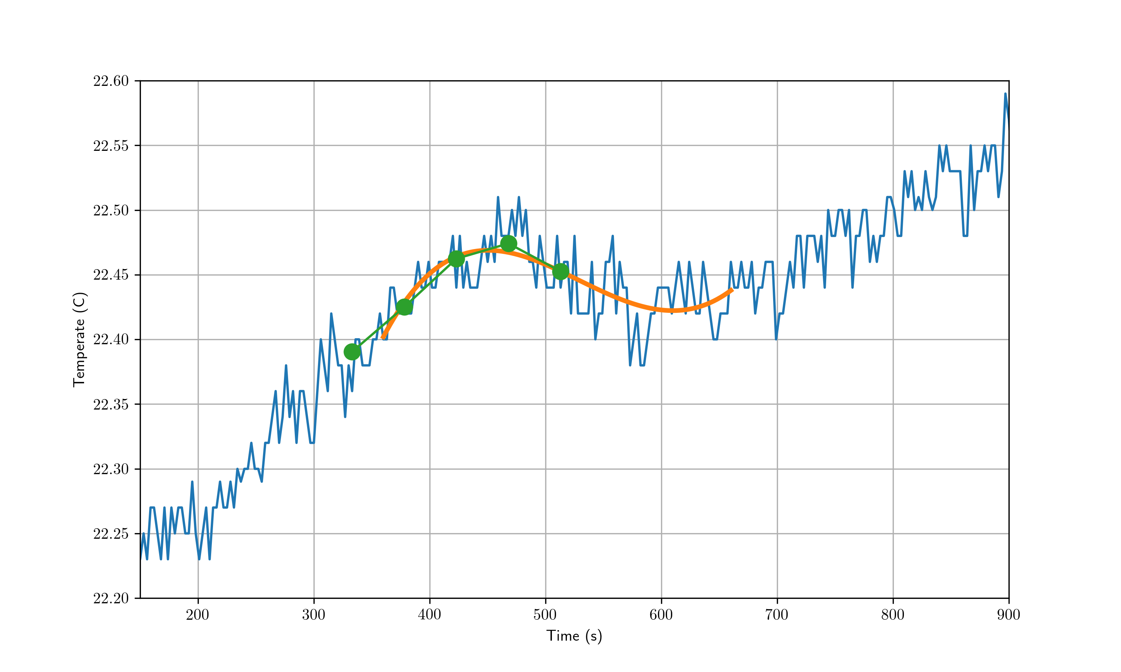
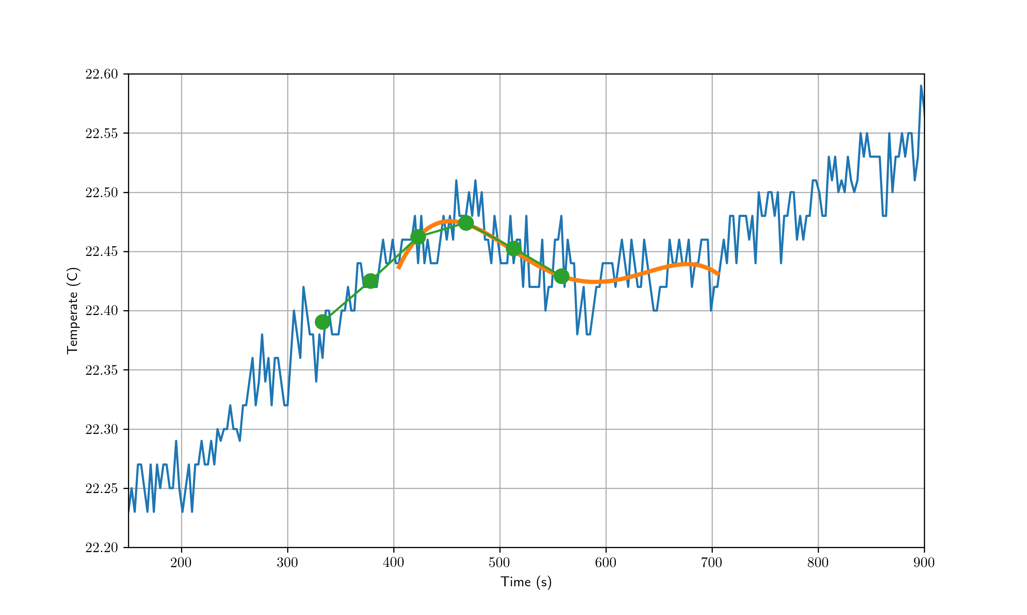
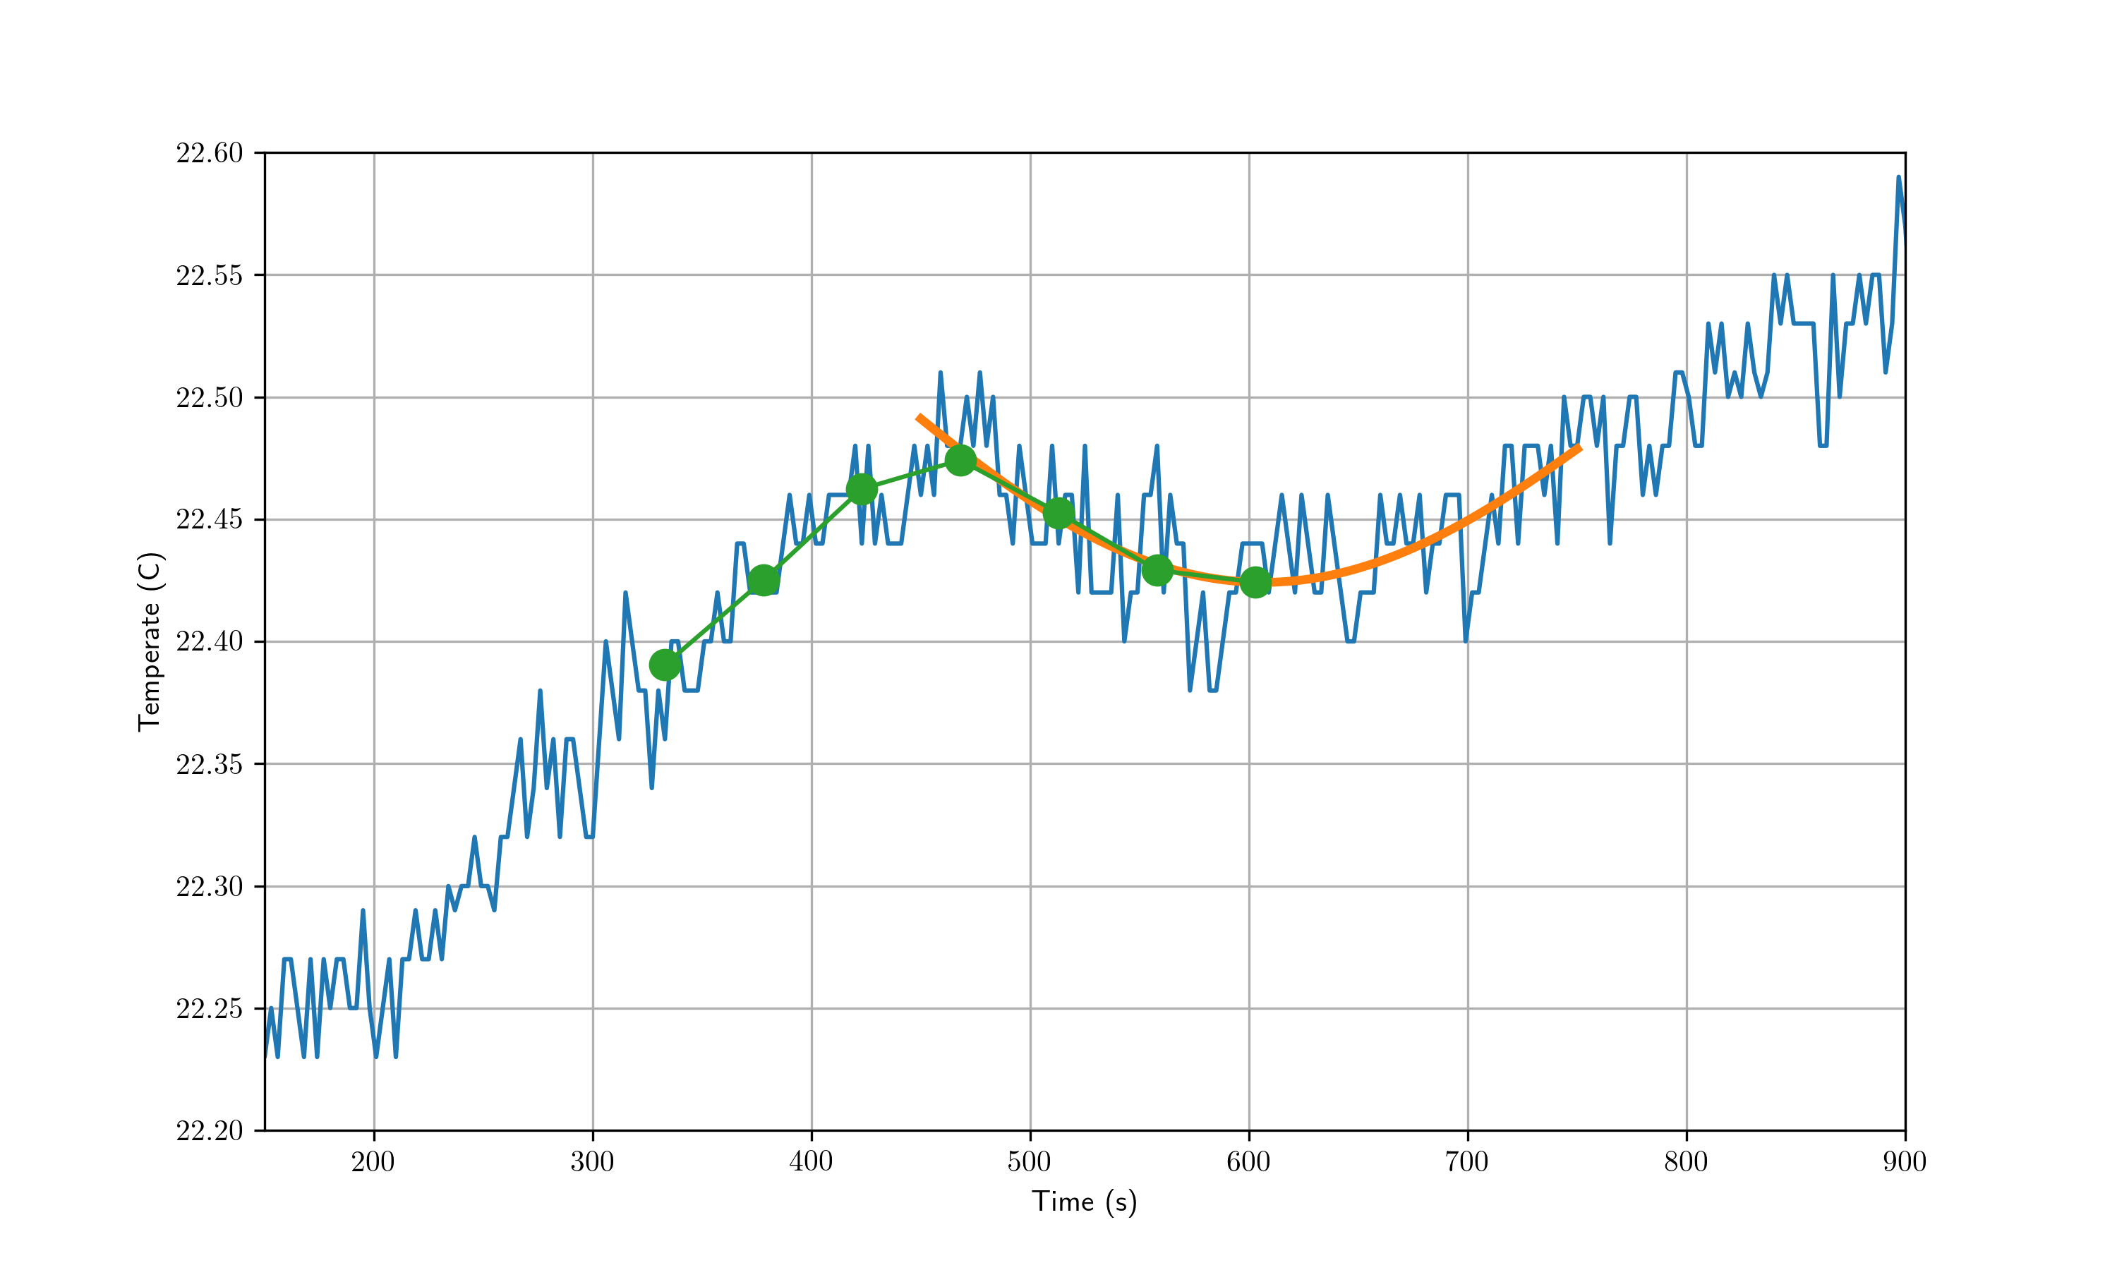
Polynomial fitting - windowing
Procedure:
Extract short-time window
Fit polynomial to window
Evaluate polynomial
e.g. at center of the window
Repeat for shifted window
y_fit = polyfit_window(y, window_length, deg)

Slide 9
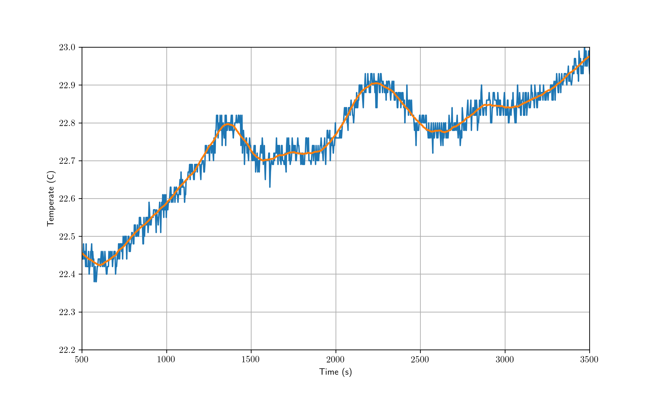
Polynomial fitting - windowing
Example:
3rd degree polynomial
100s window
Polynomial evaluated at 50s

Slide 10
Polynomial fitting - windowing
Difficult to see effect of free parameters:
Window size, polynomial degree etc.
The Savitzky-Golay (SG) filter*
Equals polynomial smoother, differently implemented
Facilitates frequency domain interpretation
Gives better interpretation of free parameters
*Savitzky, Abraham, and Marcel JE Golay. "Smoothing and differentiation of data by simplified least squares procedures." Analytical chemistry 36.8 (1964): 1627-1639.

Slide 11
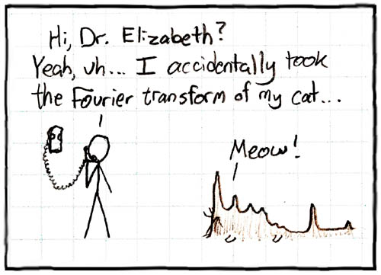
A Signal Processing Perspective
Before frequency analysis of SG-filters we need some background:
Fourier transform
Linear time-invariance
Convolution theorem
https://xkcd.com/26/

Slide 12
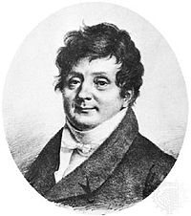
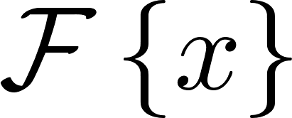
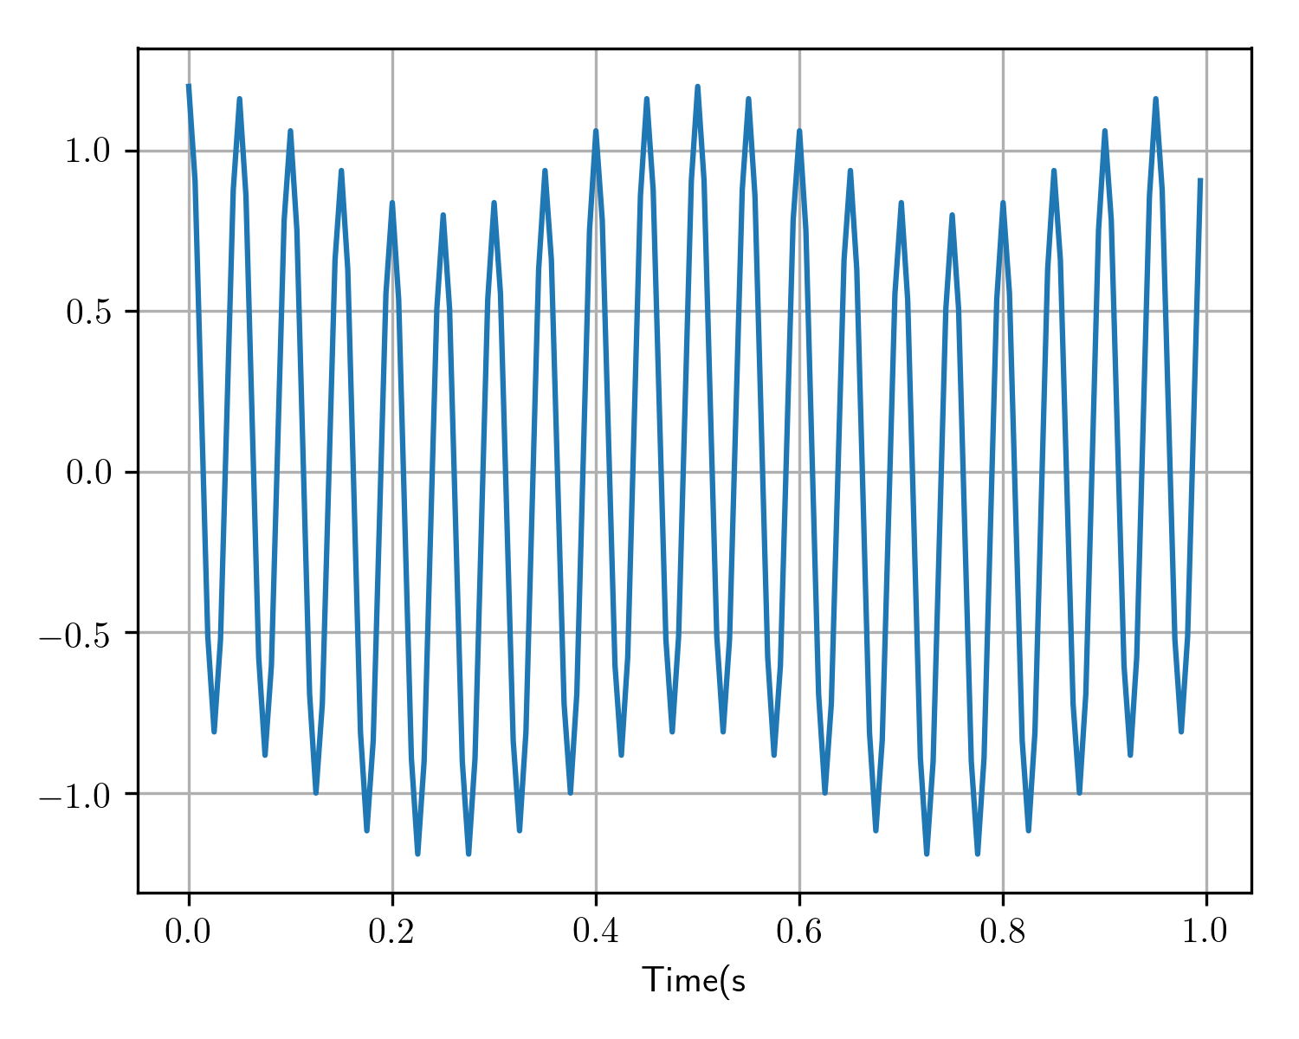
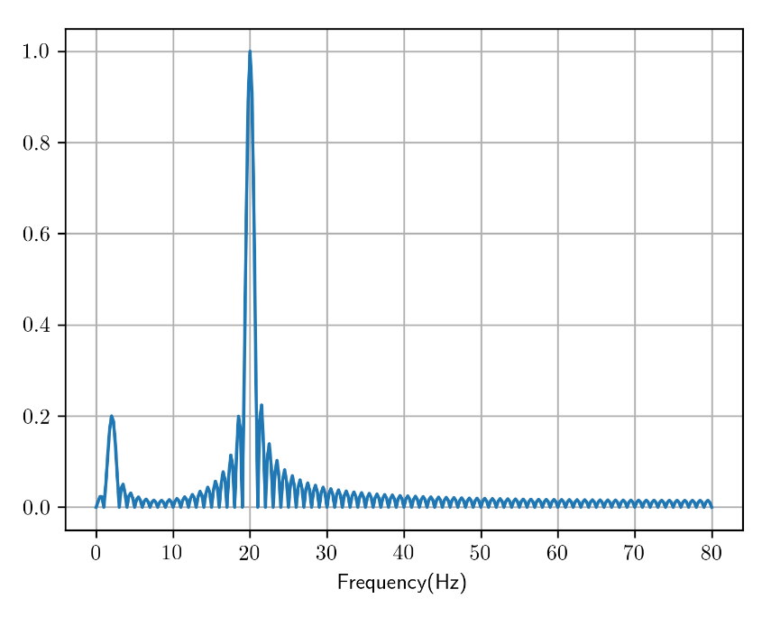
Fourier transform
Fourier transform decomposes signal into sum of sinusoidal components:
X = np.fft.fft(x)
Fourier transform
x = np.fft.ifft(X)
Inverse Fourier transform

Slide 13
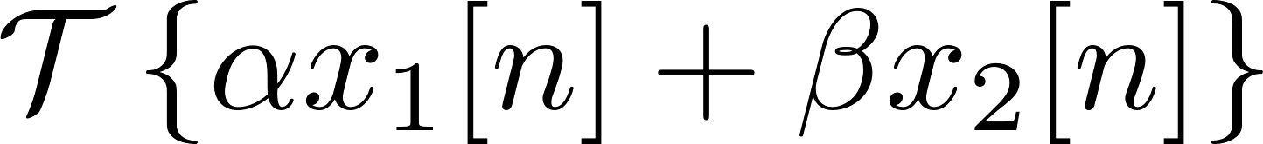
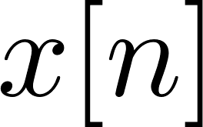

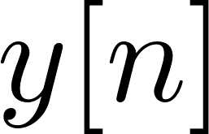

Linear Time Invariance
Polynomial smoothing is a linear time-invariant system (LTI)*
(We need this property later)
Linearity
Time Invariance:
*Schafer, Ronald W. "What is a Savitzky-Golay filter?" IEEE Signal processing magazine 28.4 (2011): 111-117.

Slide 14
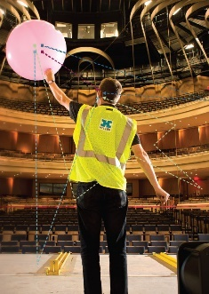
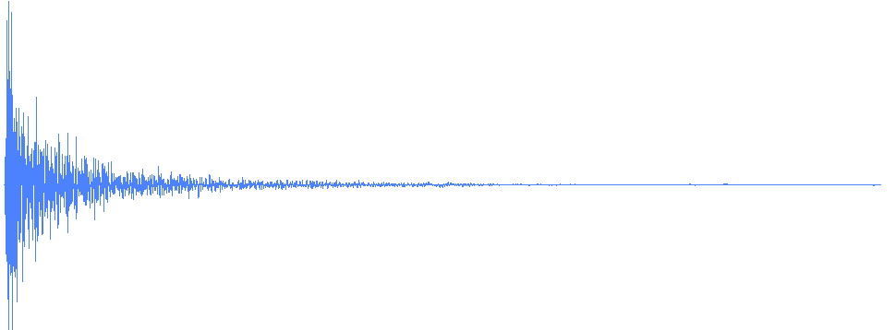
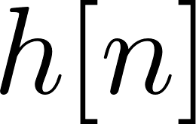
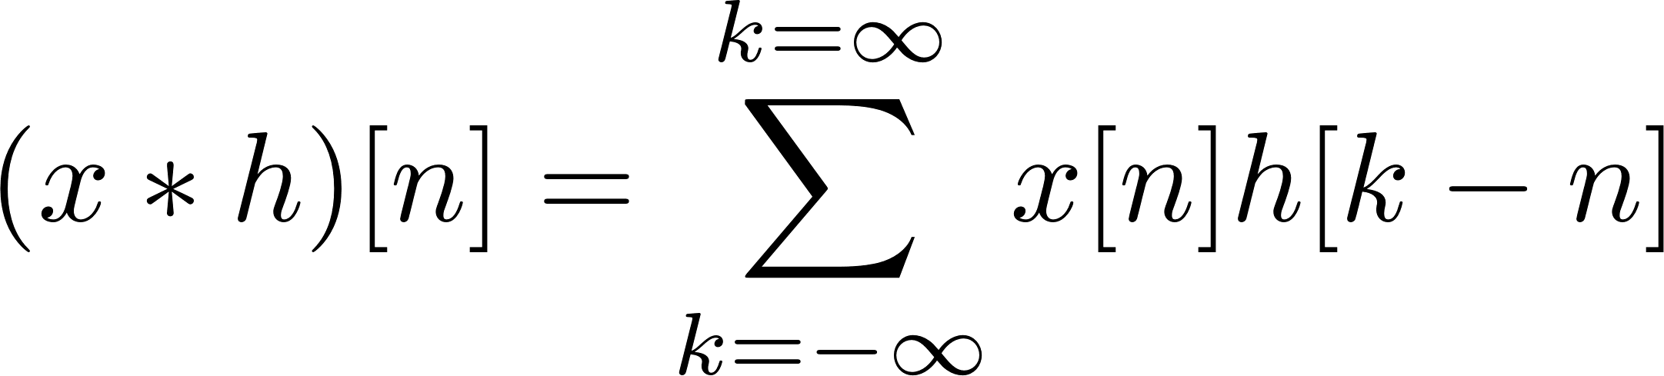
Linear Time Invariance
Any LTI-system can be fully described by its impulse response
Any LTI-system can be applied by a convolution:
import scipy.signal as sig
sig.convolve(x, h)
*Photo by Logan Wallace

Slide 15
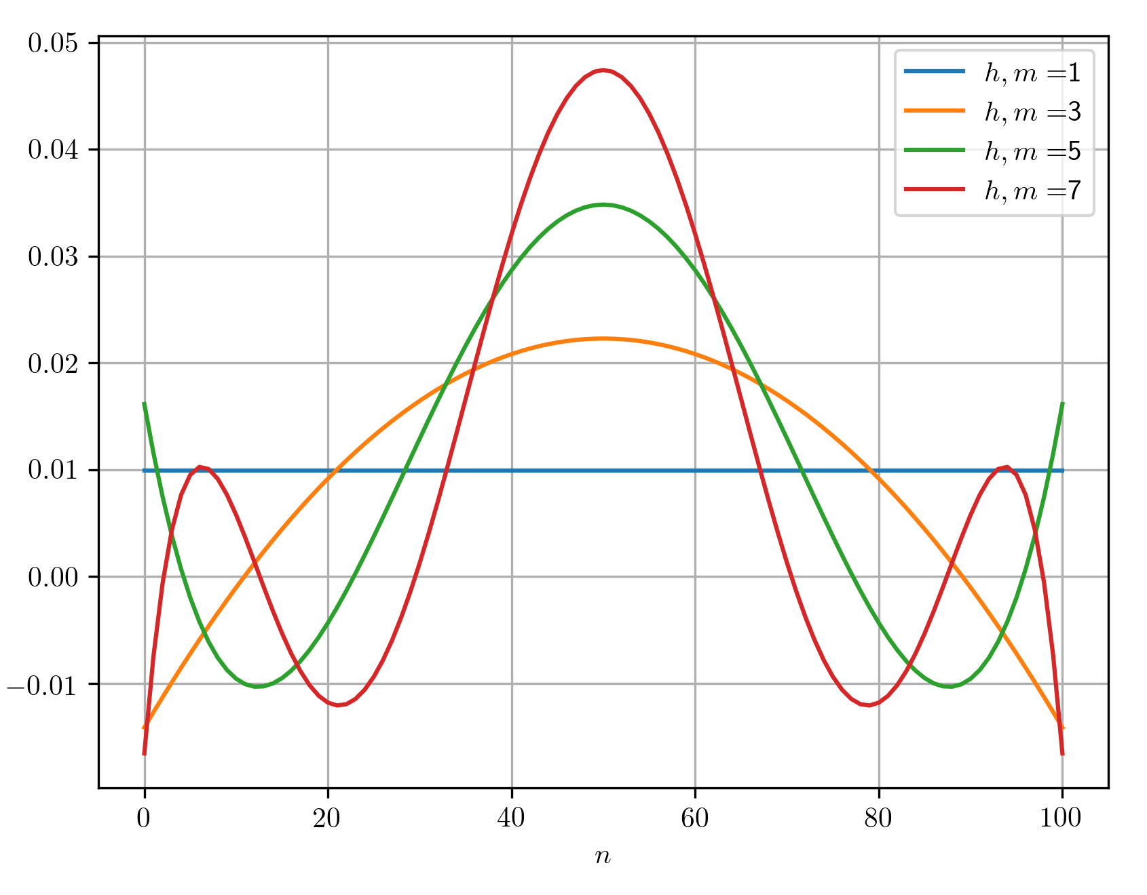
Linear Time Invariance
SG-filter impulse responses
Window length of 100 samples
Polynomial degrees [1, 3, 5, 7]
import scipy.signal as sig
h = sig.savgol_coeffs(window_length=101, polyorder=m)

Slide 16
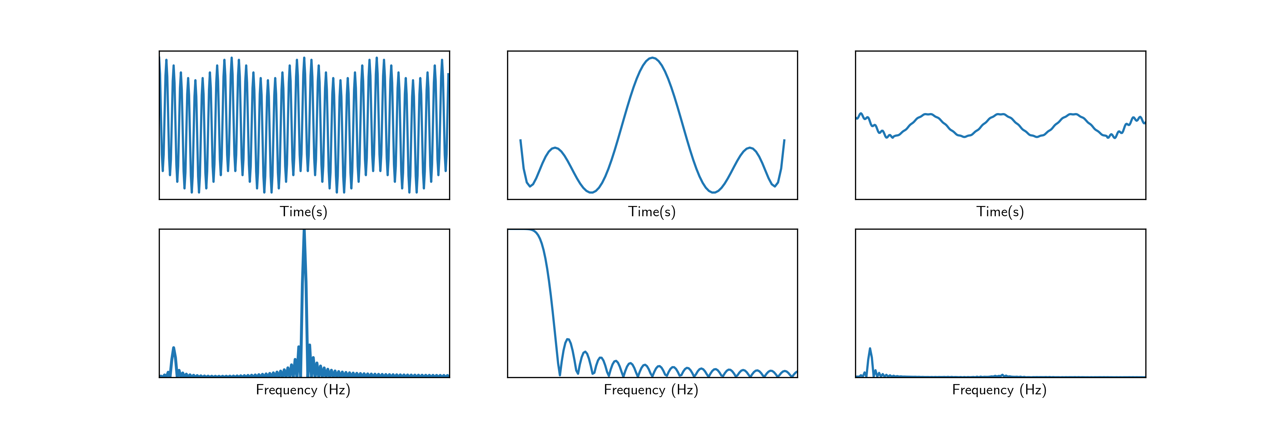

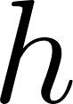
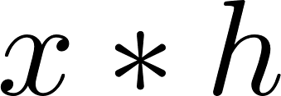
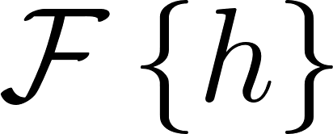
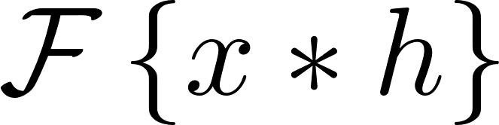
Convolution Theorem
Time-domain convolution equals frequency-domain multiplication
Input
SG Impulse R.
Output
Time-domain
Frequency-domain
(85 samples, 8th degree)

Slide 17
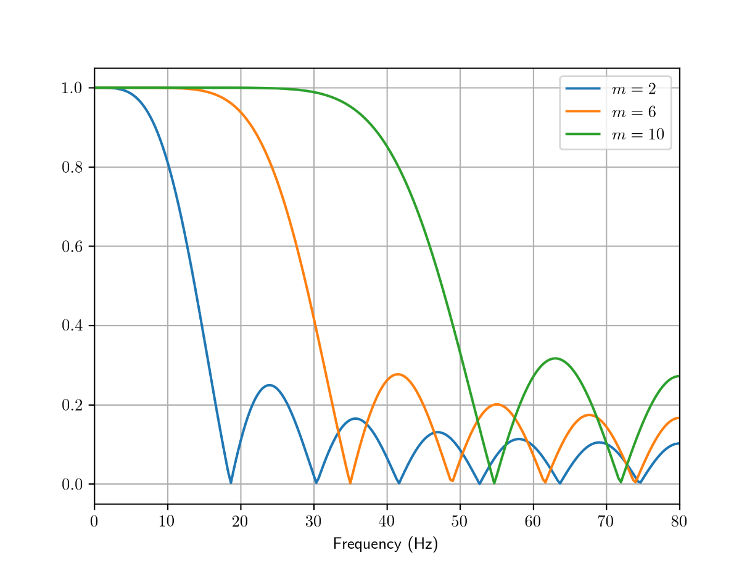
SG-Filter Frequency Response
Effect of polynomial degree
Window-length is 15 samples
Low-pass effect
Higher degree increases cutoff freq.
Little effect on slope

Slide 18
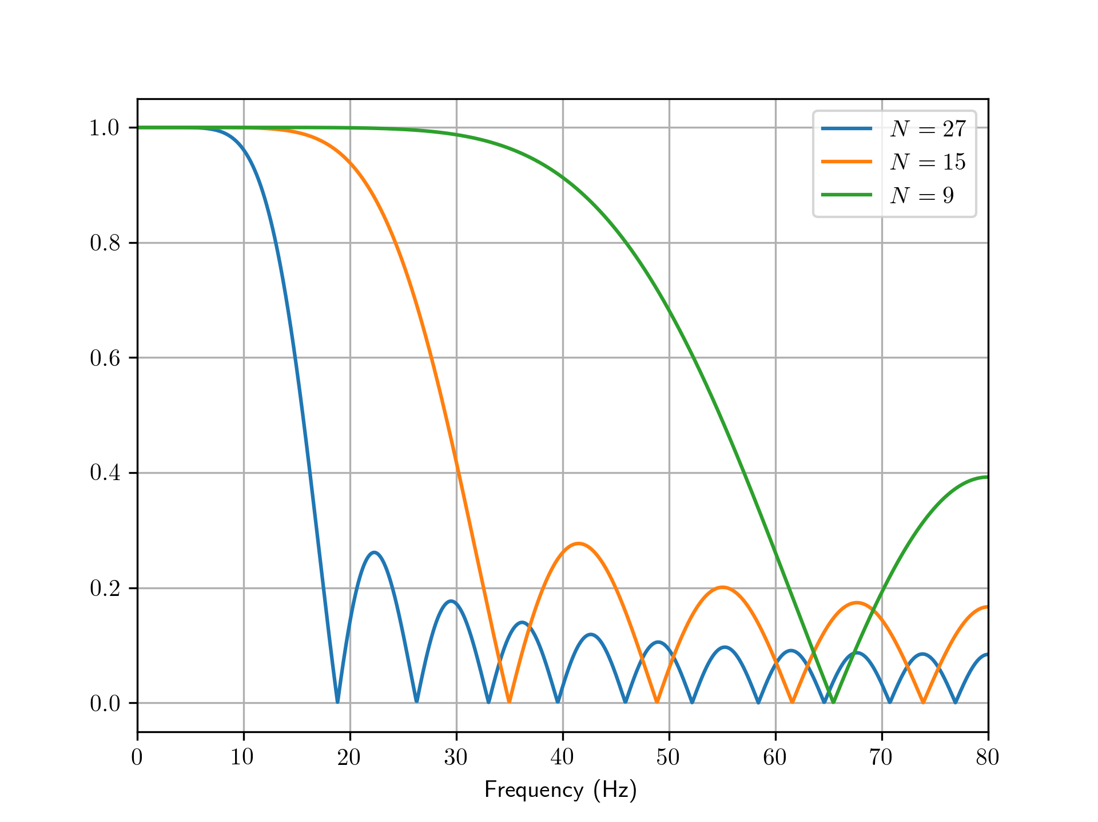
SG-Filter Frequency Response
Effect of window length N
Polynomial degree is 6
Also low-pass effect
Higher length decreases cutoff freq.
Little effect on slope

Slide 19
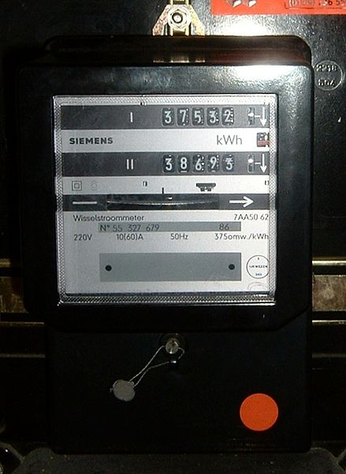
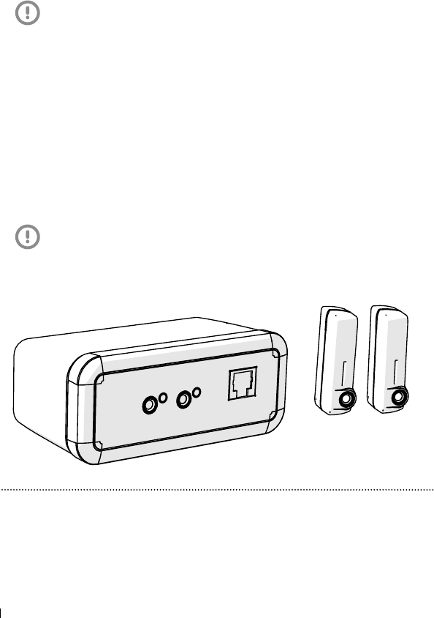
Back to the real world
Application: Electricity monitoring in the Toon
Meter module:
*Picture by Quistnix

Slide 20

Toon Electricity Monitoring
Pulse-interval measures
electricity consumption
Electricity meter
(topview)
LED
Reflected light
Sensor
Time

Slide 21
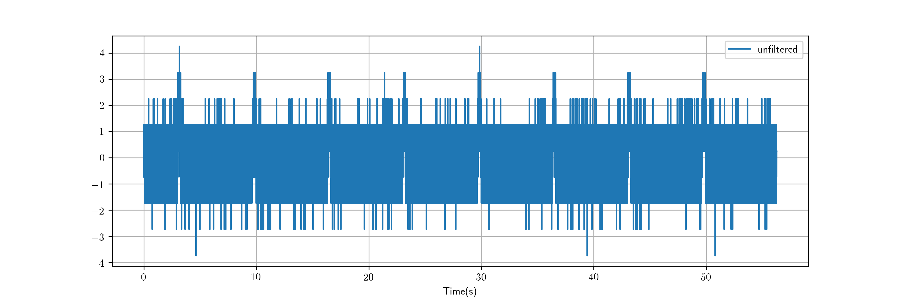
Toon Electricity Monitoring
What if you just turn off the LED?
Pulse not visible, few bits, quantization noise

Slide 22
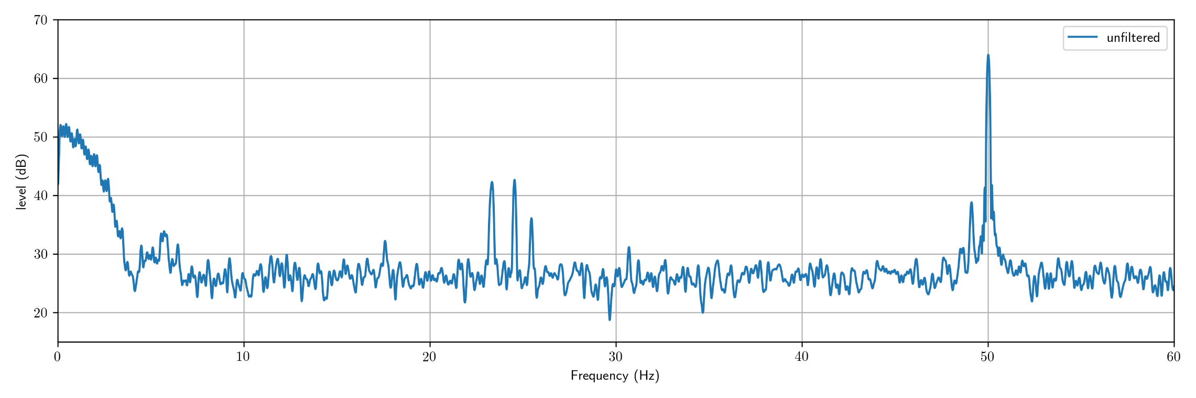
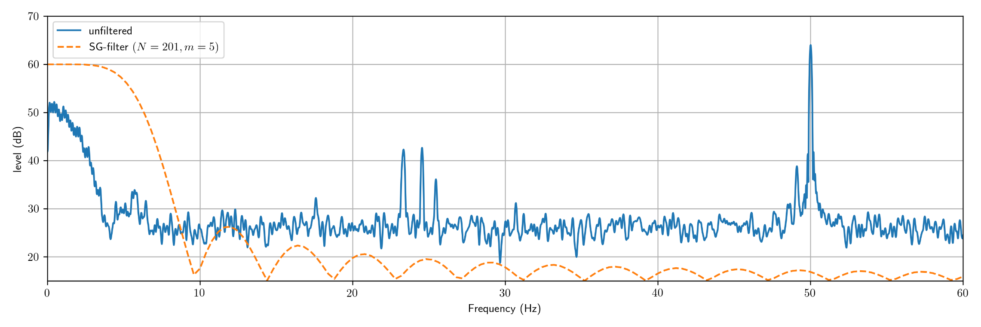
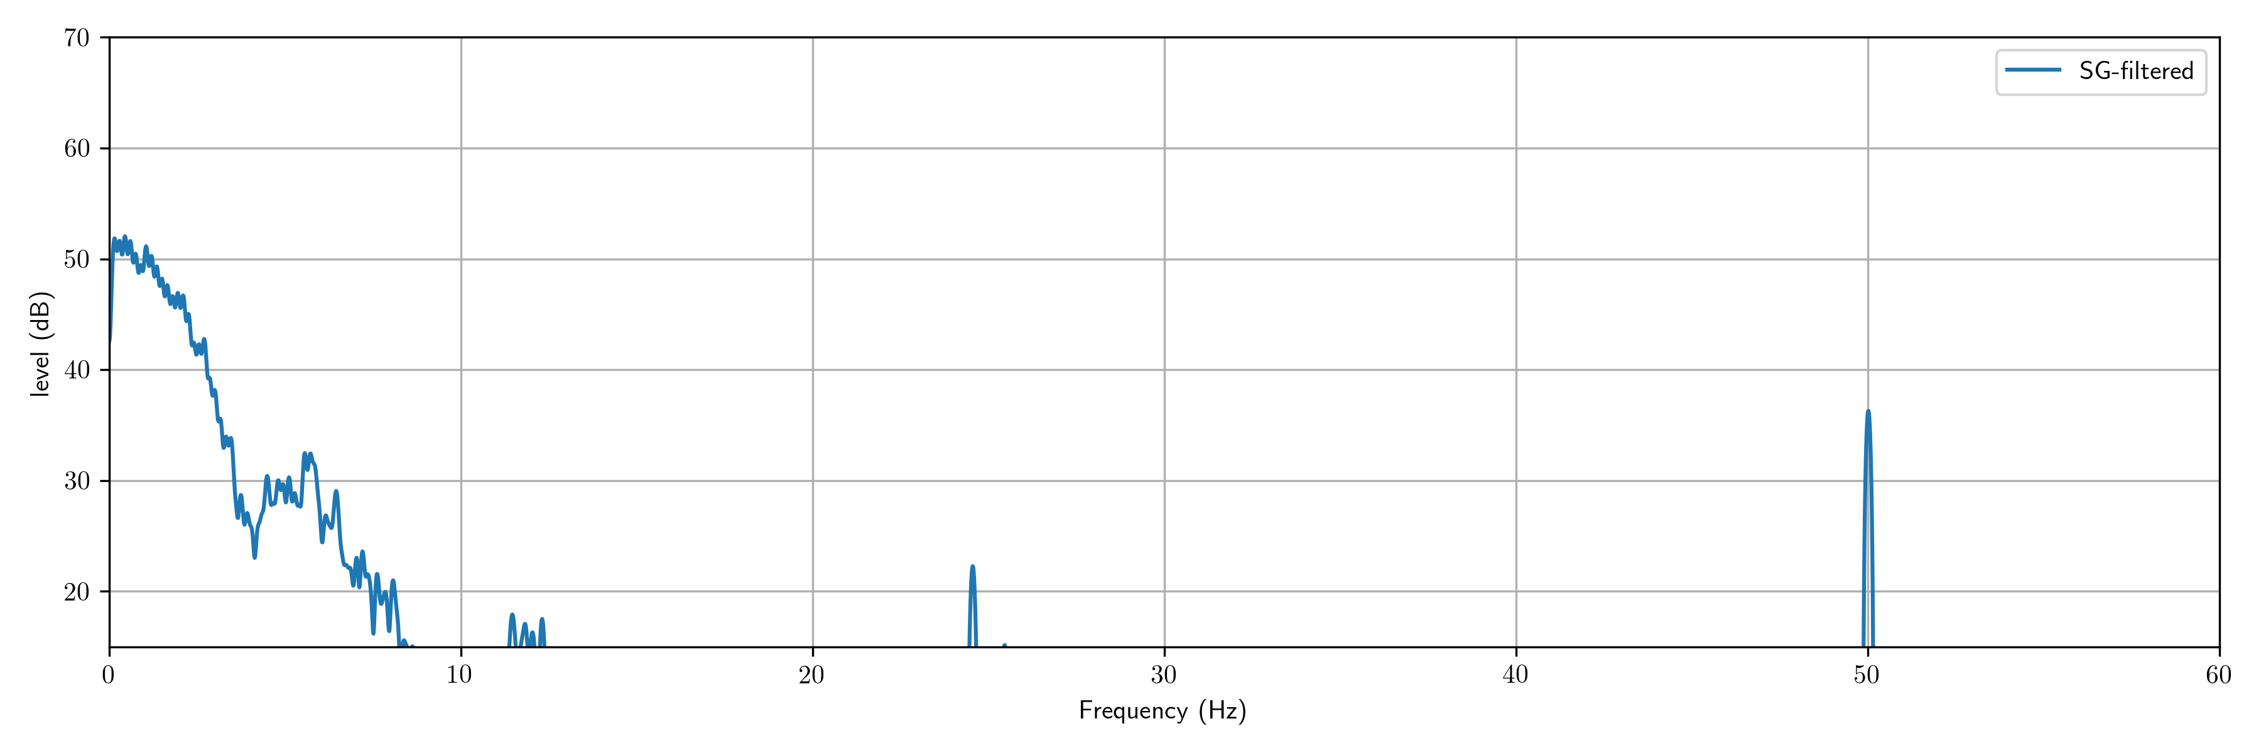
Toon Electricity Monitoring
Let’s have a look in the frequency domain
Ambient light
Pulse
Quantization noise

Slide 23

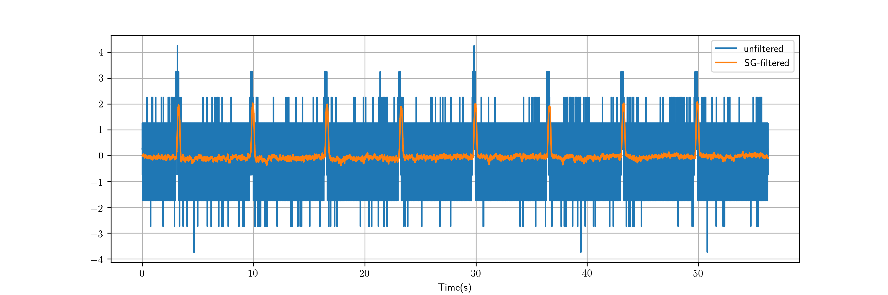
Toon Electricity Monitoring
And back to the time domain!

Slide 24
To conclude
https://github.com/chtaal/pydata2017
Polynomial filtering:
Is an LTI-system which act as a low-pass filter
Fourier analysis helps tuning free parameters
Main goal hopefully achieved:
Get acquainted with Fourier analysis
(NOT how to optimally remove noise)

Slide 25
We’re recruiting for a Data Scientist / Machine Learning Engineer!
Like math, signal processing, dirty hands? M.Sc. Thesis projects available!
https://github.com/chtaal/pydata2017
Cees Taal
cees.taal@quby.com / chtaal@gmail.com
www.toon.eu / www.ceestaal.nl

